Slide 1
ATM MACHINE

Slide 2
AIM OF THE PROJECT
AN ATM MACHINE SIMULATOR PROJECT WORKS AS AN AUTOMATED TELLER MACHINE.
IT ALLOWS THE USER TO CREATE AN ACCOUNT, DEPOSIT, WITHDRAW.
A USER CAN OBTAIN AN ATM CARD WITH PIN.

Slide 3
SOFTWARE AND HARDWARE REQUIREMENTS
HARDWARE REQUIREMENTS
Processor : intel i5
RAM : 8 gb
HARD DISK DRIVE : 500 gb
SOFTWARE REQUIREMENTS
Front End : Java Swing
Back End : MySQL, JAVA

Slide 4
PROPOSED SYSTEM
Proposed System is ATM SIMULATOR. Through our software USER CAN CREATE ACCOUNT, DEPOSIT, WITHDRAW.
User friendly interface.
Easy access to database.
BALANCE ENQUIRY, FAST CASH, MINI STATEMENT FACILITY.
More Storage.

Slide 5
MODULE LIST
DEPOSIT
WITHDRAW
FAST CASH
BALANCE ENQUIRY
MINI STATEMENT
PIN CHANGE

Slide 6
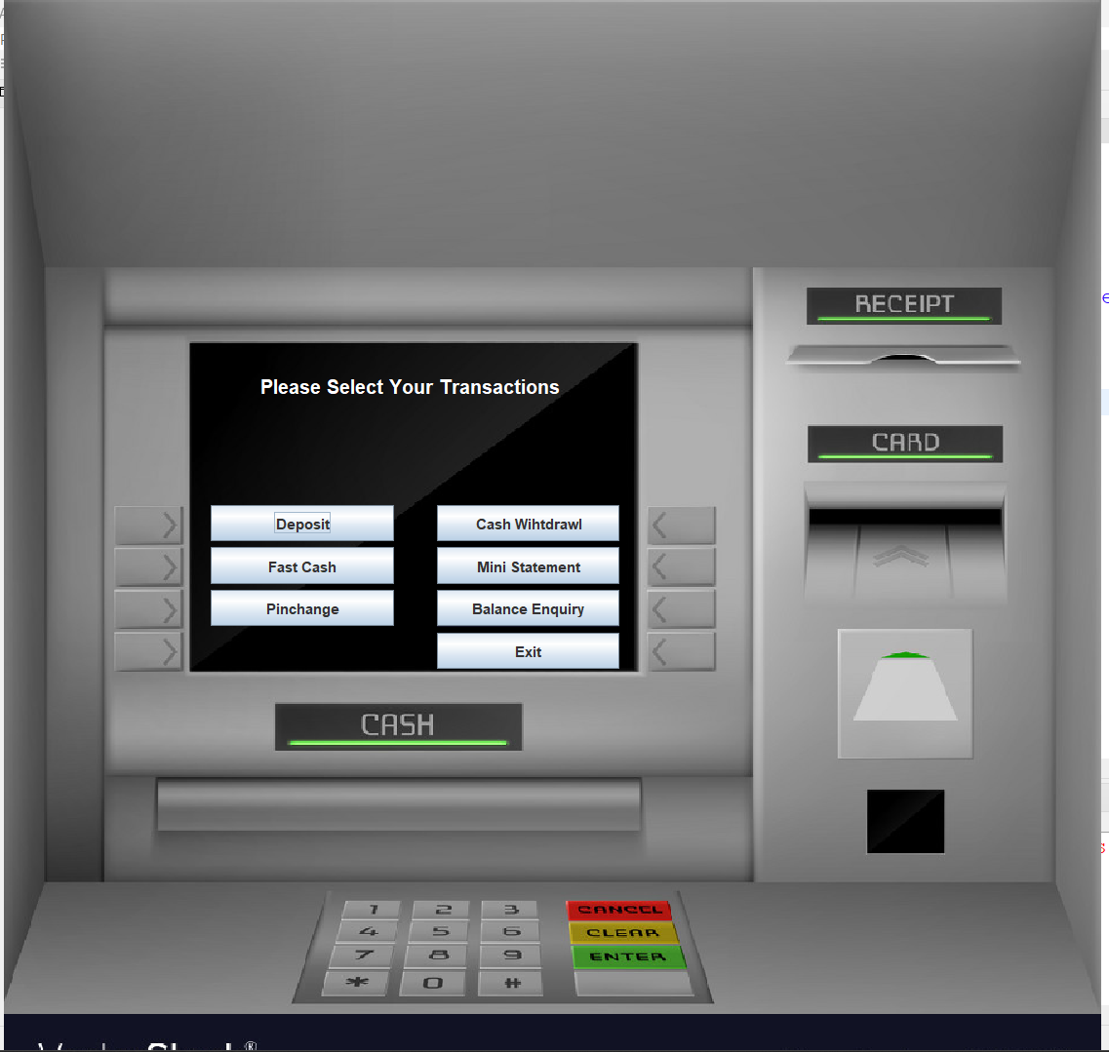
HOME SCREEN

Slide 7
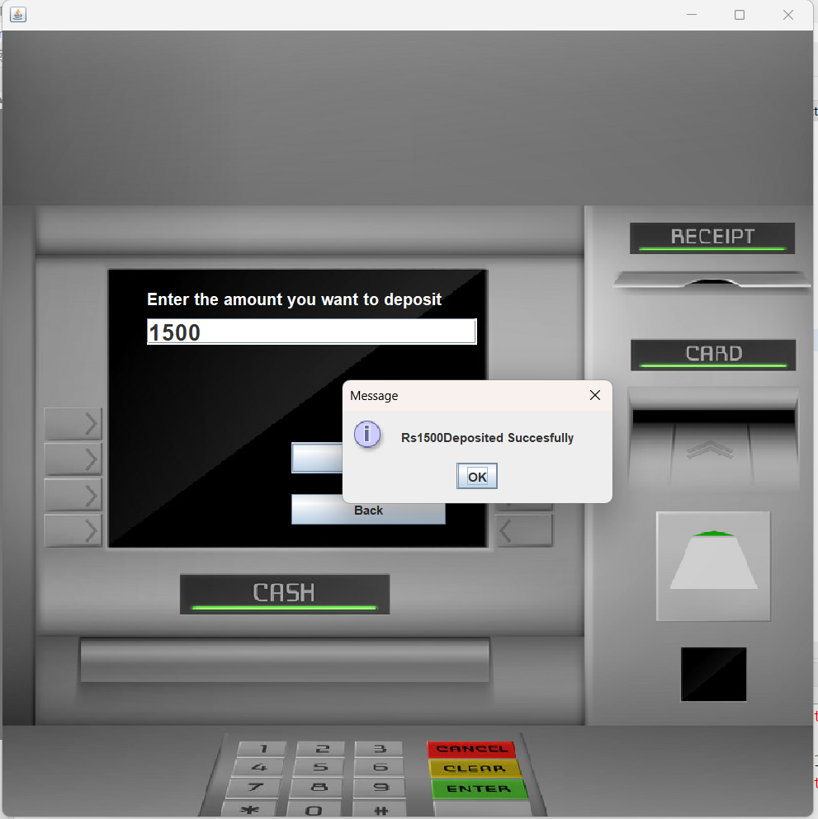
DEPOSIT

Slide 8
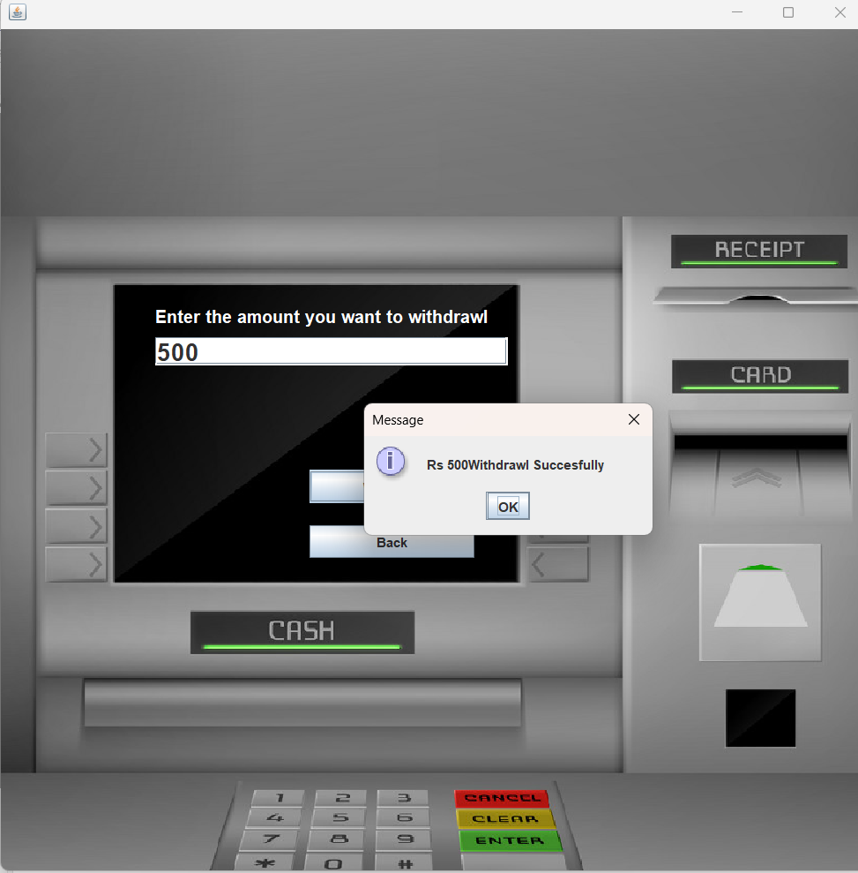
WITHDRAW

Slide 9
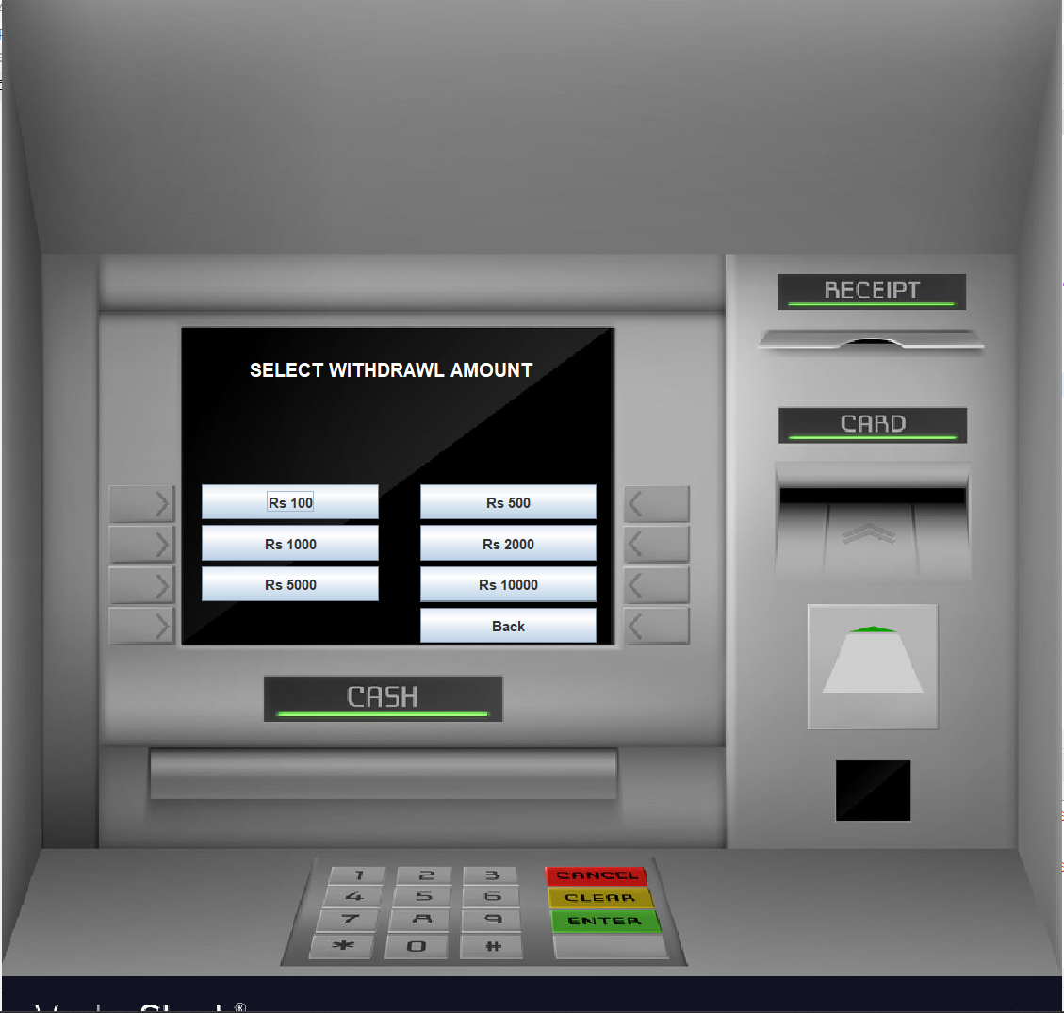
FAST CASH

Slide 10
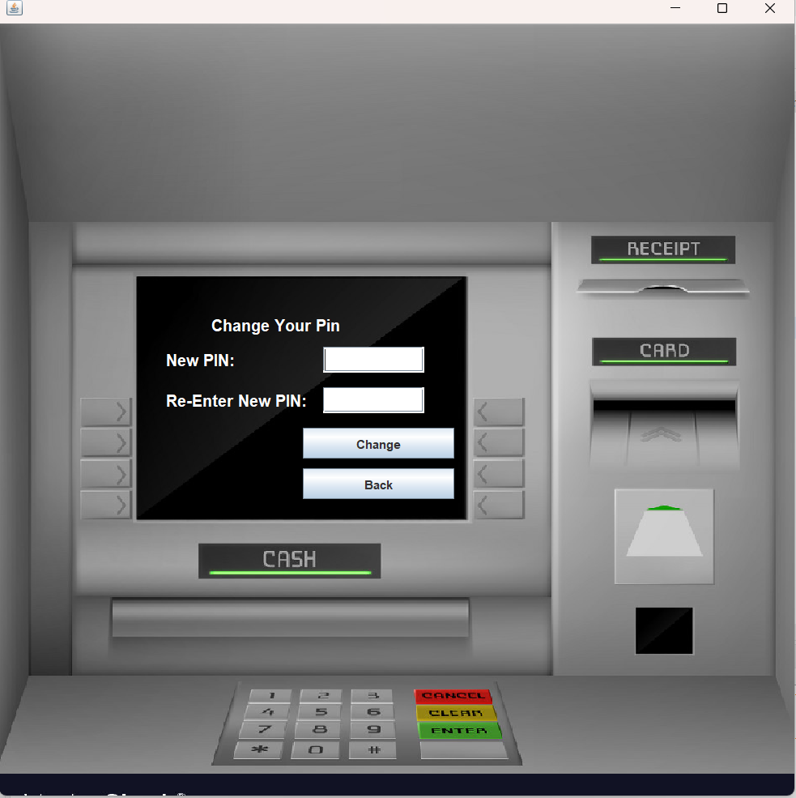
PIN CHANGE

Slide 11
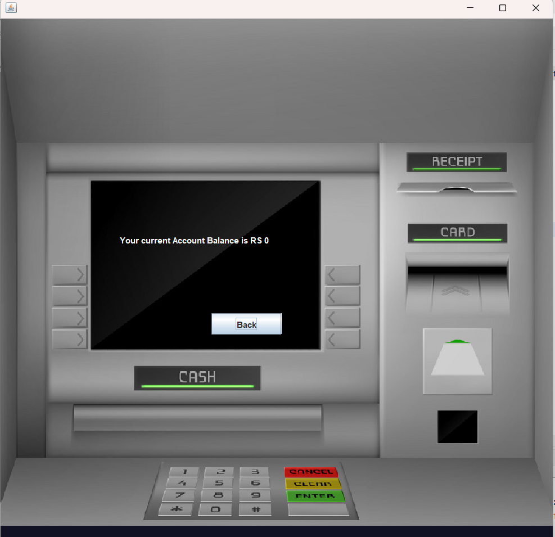
BALANCE ENQUIRY

Slide 12
THANK YOU

